Slide 1




Space technology for water resource management and hydrology
Geospatial Indices as a measure of Influential and managing priority situation of groundwater storage anomaly
by
Dr. Khalid Mahmood
(Space4water Professional)
(Assistant Professor, Space Science, university of the Punjab, Pakistan)
(Co-PI, Remote Sensing, gis and climatic research lab, ncgsa, Pakistan)

Slide 2
Introduction
Groundwater is an invaluable resource helping to sustain industrial, agricultural and domestic activities throughout the globe. It is being utilized in excess, especially in highly populated and arid regions with insufficient freshwater resources i.e. Pakistan, India, China, North Africa and Middle East
In most of the South Asian region, consumption of groundwater is higher than the rate of aquifer replenishment, leading to drought conditions

Slide 3
The purpose
The main purpose of this talk is to present space-based data model to aid hydrologists to understand the response patterns of groundwater reserves to various hydro-climatic, biophysical and demographic variables.
The main objectives of the study are to compute groundwater storage changes for major countries of South Asia i.e., India, Pakistan, Nepal, Bangladesh, Afghanistan; to see its relationship with the controlling factors using optimal model and to country wise rank individual controlling parameter and to assess management situation of groundwater controlling variables in each of the country at various levels.

Slide 4
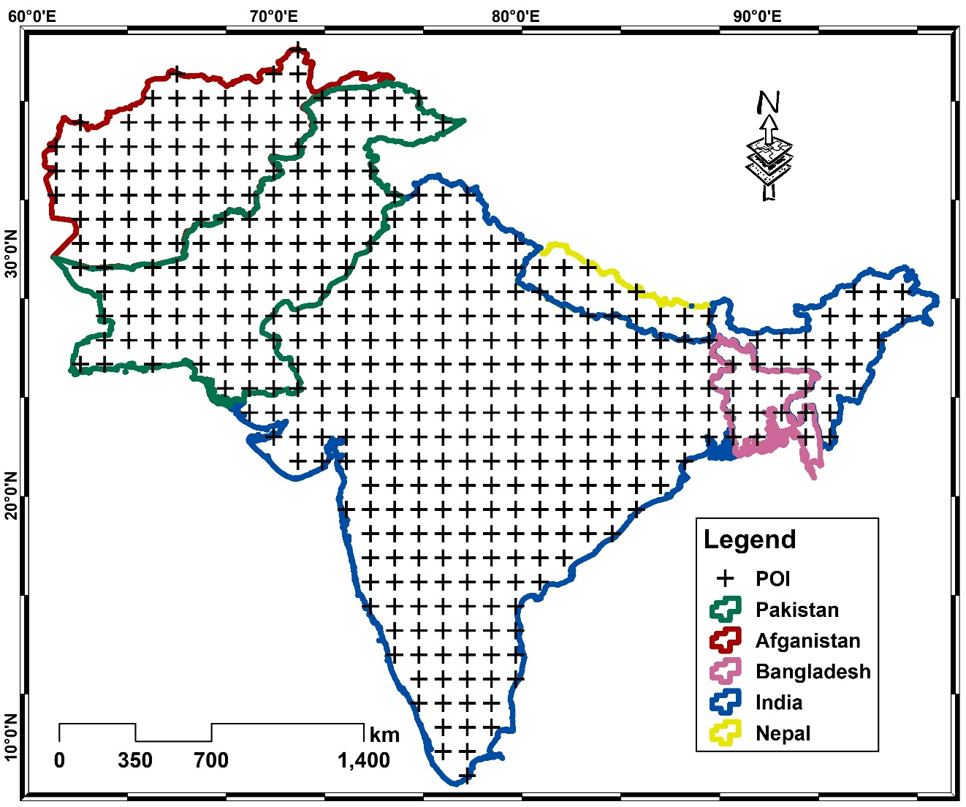
Study Area

Slide 5
Datasets
Category | Variable | Resolution | Data source
Water storage | Groundwater storage anomaly | 1° | GRACE
Climatic and Hydro-climatic | Precipitation | 0.1° | GPM-IMERG
 | Temperature | 0.01° | FLDAS
 | Soil Moisture | 0.5° | TerraClimate
 | Runoff | 0.5° | TerraClimate
 | Evapotranspiration | 0.01° | FLDAS
Biophysical | NDVI | 1km | MODIS(MYD13A2)
Demographic | Population Density | 0.5° | SEDAC

Slide 6
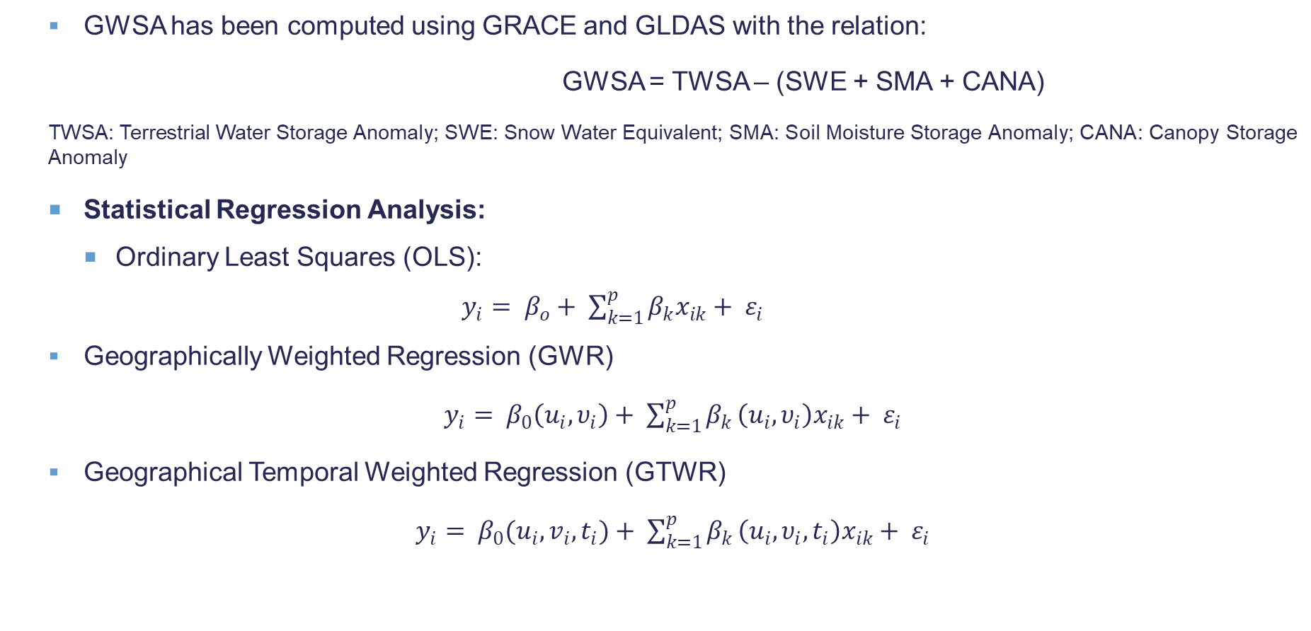
Methodology
  GWSA has been computed using GRACE and GLDAS with the relation:
                GWSA = TWSA – (SWE + SMA + CANA)
  TWSA: Terrestrial Water Storage Anomaly; SWE: Snow Water Equivalent; SMA: Soil Moisture Storage Anomaly; CANA: Canopy Storage Anomaly
  Statistical Regression Analysis:
    Ordinary Least Squares (OLS):
    $y_{i}= β_{o}+ \sum_{k=1}^{p}{β_{k}x_{ik}+ ε_{i}}$
  Geographically Weighted Regression (GWR)
  $y_{i}= β_{0}\left(u_{i}, υ_{i}\right)+ \sum_{k=1}^{p}{β_{k }\left(u_{i}, υ_{i}\right)x_{ik}+ ε_{i}}$
  Geographical Temporal Weighted Regression (GTWR)
  $y_{i}= β_{0}(u_{i}, v_{i}, t_{i})+ \sum_{k=1}^{p}{β_{k }\left(u_{i}, υ_{i}, t_{i}\right)x_{ik}+ ε_{i}}$

Slide 7
Methodology
  Groundwater Management Index
  GTWR provides importance of individual controlling variables (Influence Factor) for GWSA and its temporal variation over time. The temporal variation (Controlling Trend) represents changing effect of a parameter in a region that mark rate of control over time, positive for improved efficiency with time and vice versa. This rate of change times importance of a parameter for a country has been used as a priority index value of an individual controlling factor for sustainability of GWSA. Sum of priority index values for a country has been used as Groundwater Management Index (GW-Management Index), showing an overall rank for management of controlling factor that support sustainability of GWSA.

Slide 8
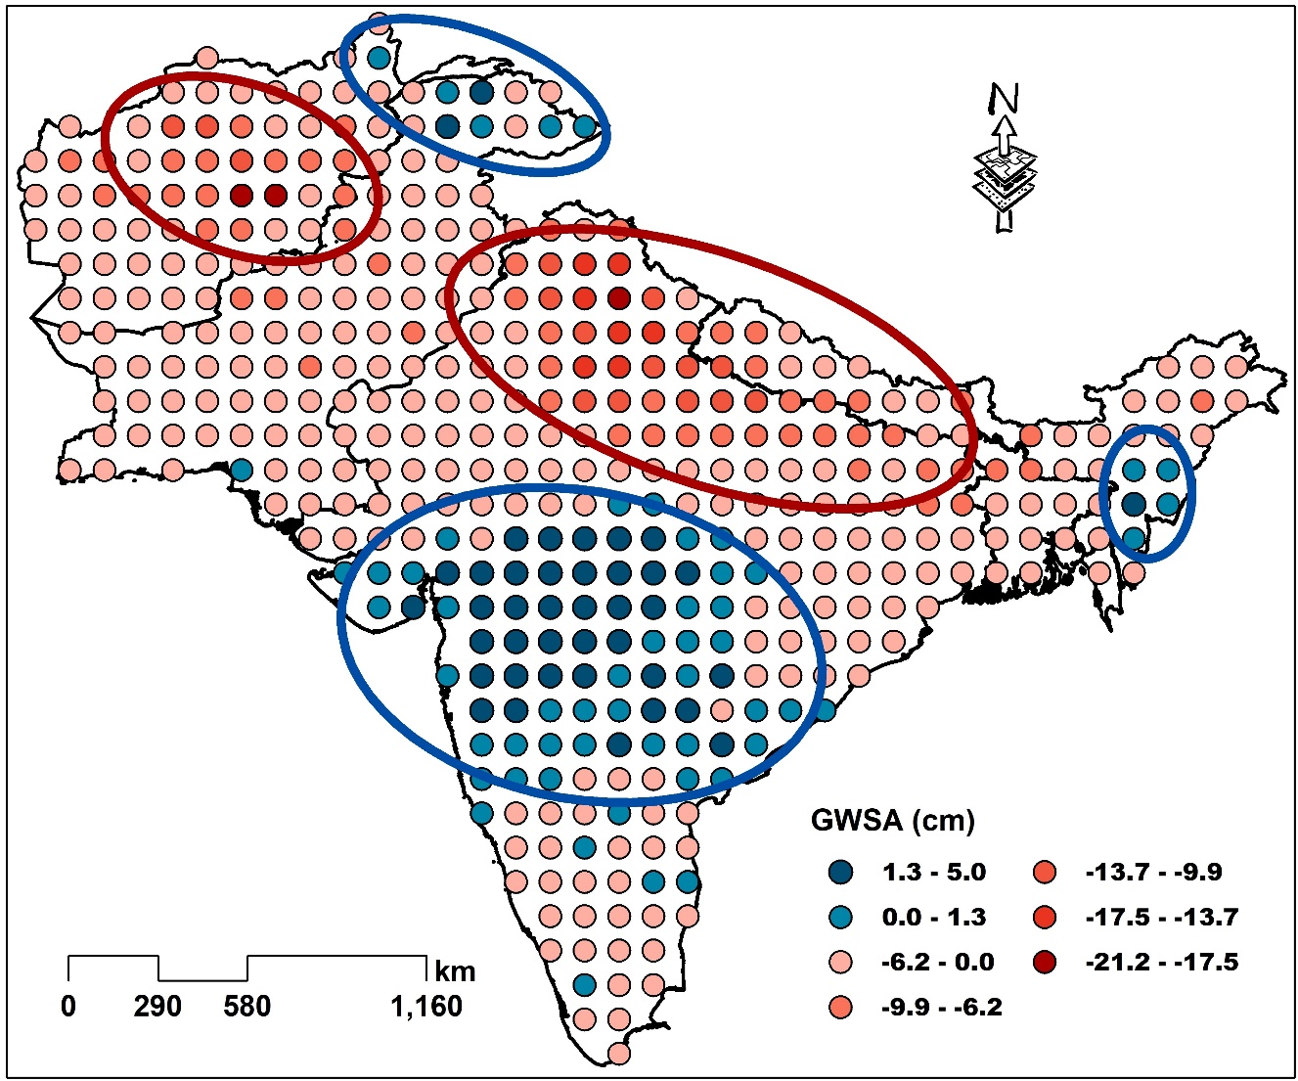
Results and Discussion
Accumulative Spatial Heterogeneity of GWSA over South Asia

Slide 9
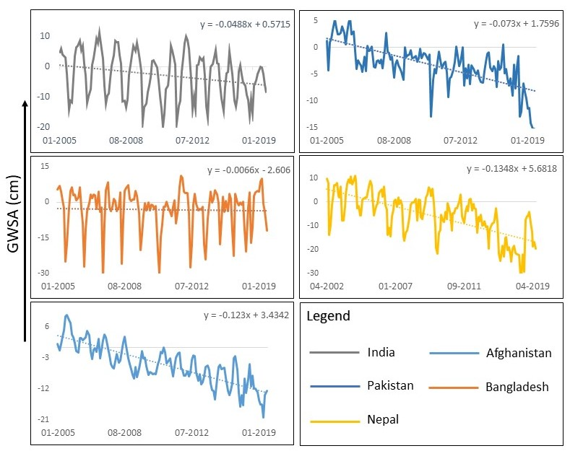
Results and Discussion
Temporal Variation of GWSA

Slide 10
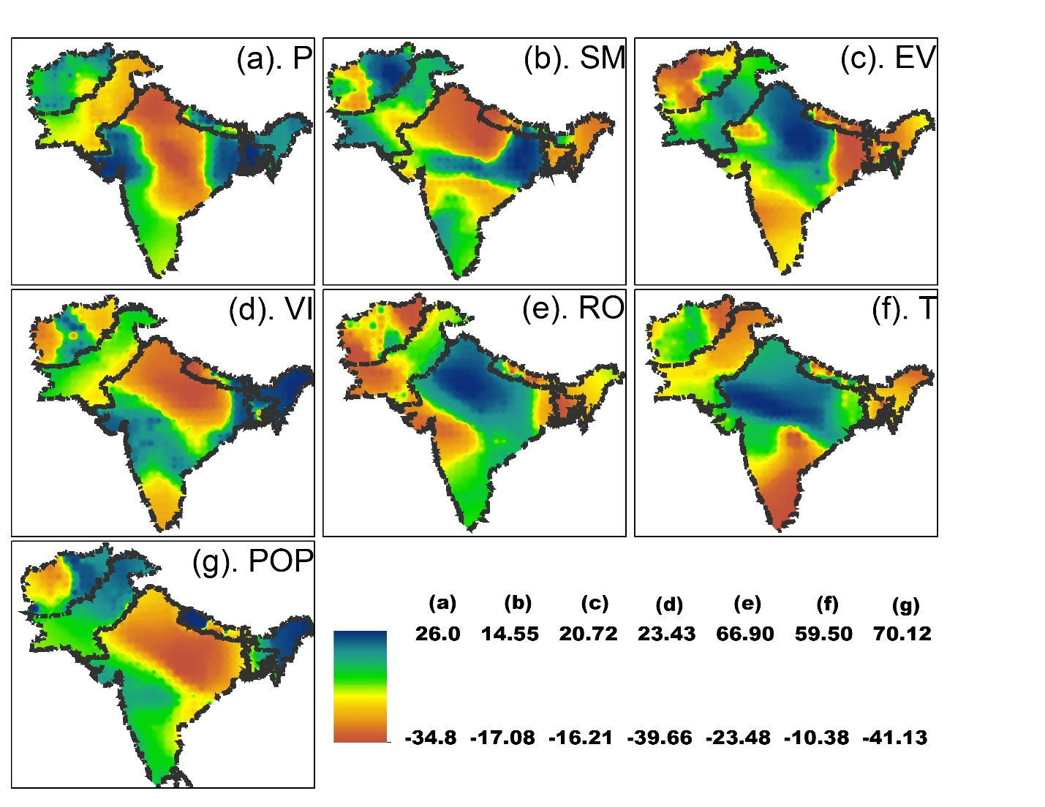
Results and Discussion
Spatial Impact of controlling Factors on GWSA

Slide 11
Results and Discussion
Regional classification of Influence and management factors of GWSA
Region |  | India | Pakistan | Afghanistan | Bangladesh | Nepal
PoP | Influence Factor | 4.03 | 1.64 | 1.84 | 0.52 | 0.63
 | Controlling Trend | -0.94 | 0.85 | 0.66 | 0.34 | -9.7
RO | Influence Factor | 8.36 | 2.5 | 0.48 | 6.3 | 1.49
 | Controlling Trend | 2.33 | -8.9 | -4.03 | -3.81 | 1.88
T | Influence Factor | 6.65 | 1.12 | 1.71 | 2.8 | 0.45
 | Controlling Trend | 8.07 | 2.15 | -1.69 | 2.84 | -2.24
P | Influence Factor | 11.3 | 14.8 | 5.61 | 10.83 | 8.05
 | Controlling Trend | 2.15 | -1.84 | -0.6 | 2.17 | 0.44
NDVI | Influence Factor | 0.73 | 1.99 | 0.71 | 2.73 | 1.6
 | Controlling Trend | 0.77 | -1.18 | -0.34 | 0.79 | 1.91
SM | Influence Factor | 0.06 | 3.12 | 3.38 | 3.97 | 4.63
 | Controlling Trend | -0.07 | 0.56 | 2.04 | -0.45 | 0.66
ET | Influence Factor | 3.16 | 4.98 | 0.8 | 4.15 | 5.53
 | Controlling Trend | -1.96 | 3.03 | -0.98 | 1.11 | -0.55
GW-Management Index |  | 88 | -31.2 | -1.1 | 12.6 | 2.3

Slide 12
Conclusions and recommendations
Groundwater is continuously depleting with time in the entire study area, however, greatest groundwater loss of -0.13cm/year and -0.12cm/year has been observed for Nepal and Bangladesh, respectively.
Diversions in the transboundary rivers driven aquifer stress is also prominent among the studied countries.
It has been analyzed that precipitation is the major controlling factor of groundwater changes in South Asian region with strength of controlling hierarchy as Pakistan>India>Bangladesh>Nepal>Afghanistan.
Pakistan having aquifer most sensitive to precipitation requires to manage this factor well for sustainability, but it is continuously losing its control (at the rate of -1.84) in managing precipitation to support underground aquifer.
After precipitation runoff and evapotranspiration are strong factors.

Slide 13
Conclusions and recommendations
Long term groundwater storage changes are also associated with increase in population and anthropogenic activities such as urbanization and large-scale extraction for irrigation.
The overall groundwater management index rank India at top of the list with score of 88 points, Bangladesh and Nepal are also positive on the scale with scores of 12.6 and 2.3, respectively.
Countries with overall negative management factor are Pakistan and Afghanistan with scores of -31.2 and -1.1 respectively.
Among the negative management score holding countries common factors is the political instability that has never let the countries under long term planning to set base for coping up climate change, its affects and mushroom growth in certain regions.
The developed model for assessing regional importance of individual controlling factors and regional ability to manage these factors can help policy makers to focus and priorities development for groundwater sustainability.

Slide 14
THANK YOU

